Slide 1
Photomicrographs of Plant foods
Radish
Permission to reproduce original photomicrographs used to make this collection may be obtained from
Dr. David O. Norris at
david.norris@colorado.edu

Slide 2
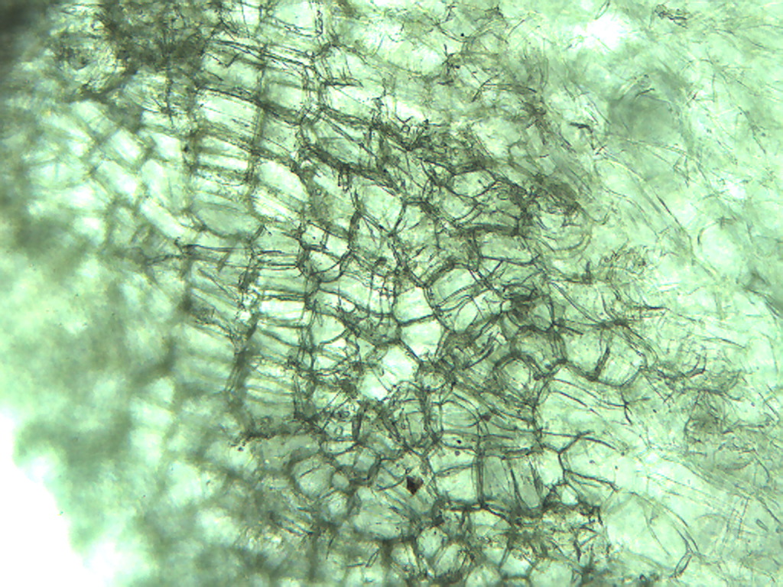
Notes:
422. Raphanus sativus L. Radish. Epidermal cells of root, 10X.

Slide 3
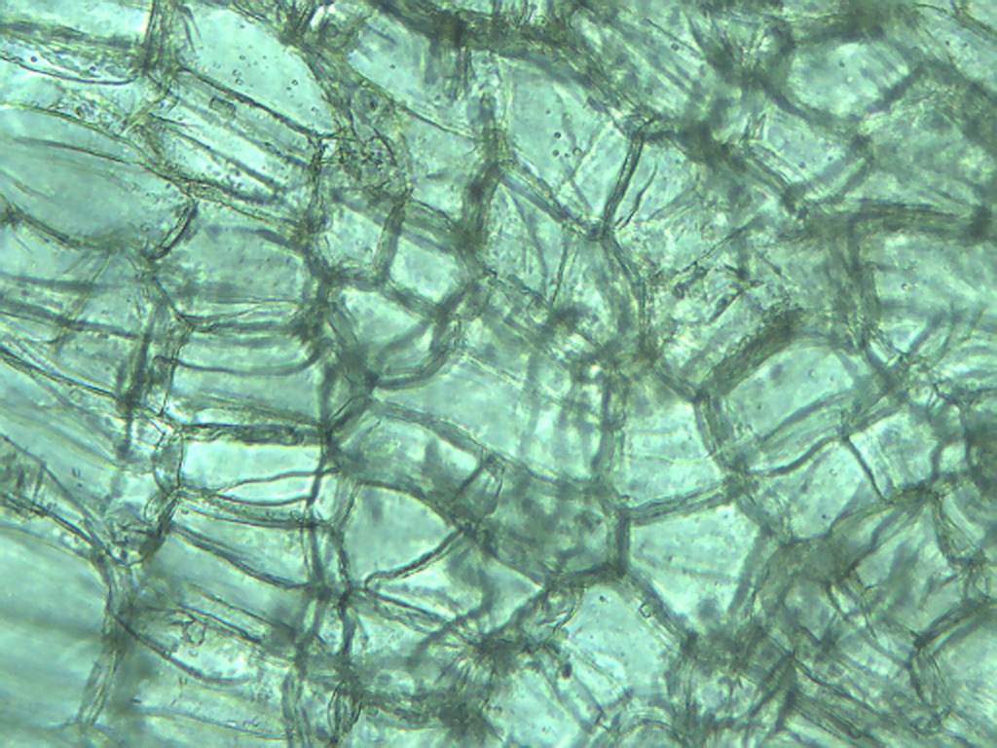
Notes:
423. Radish. Root epidermal cells, 25X.

Slide 4
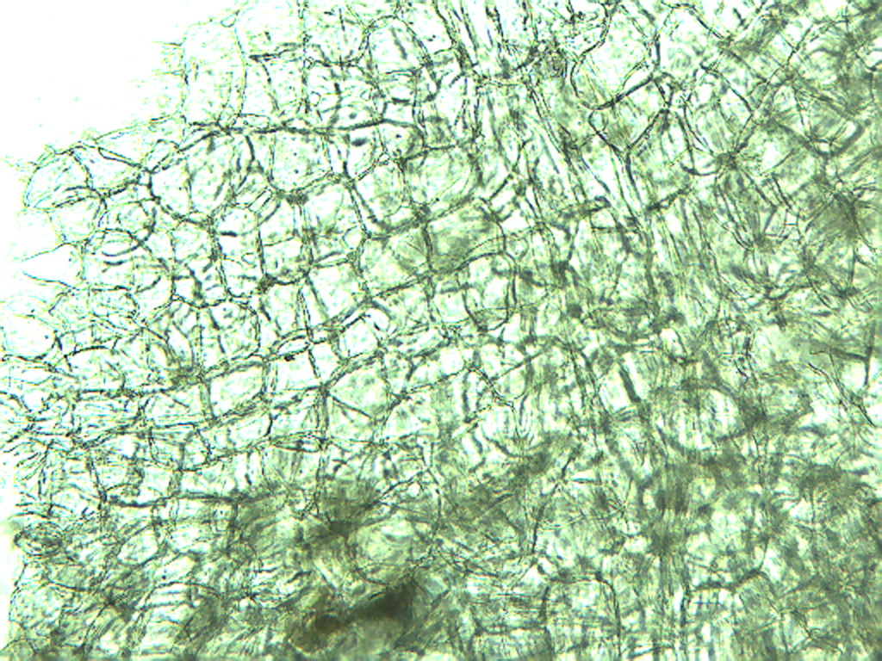
Notes:
424. Radish. Root cells, 10X.

Slide 5
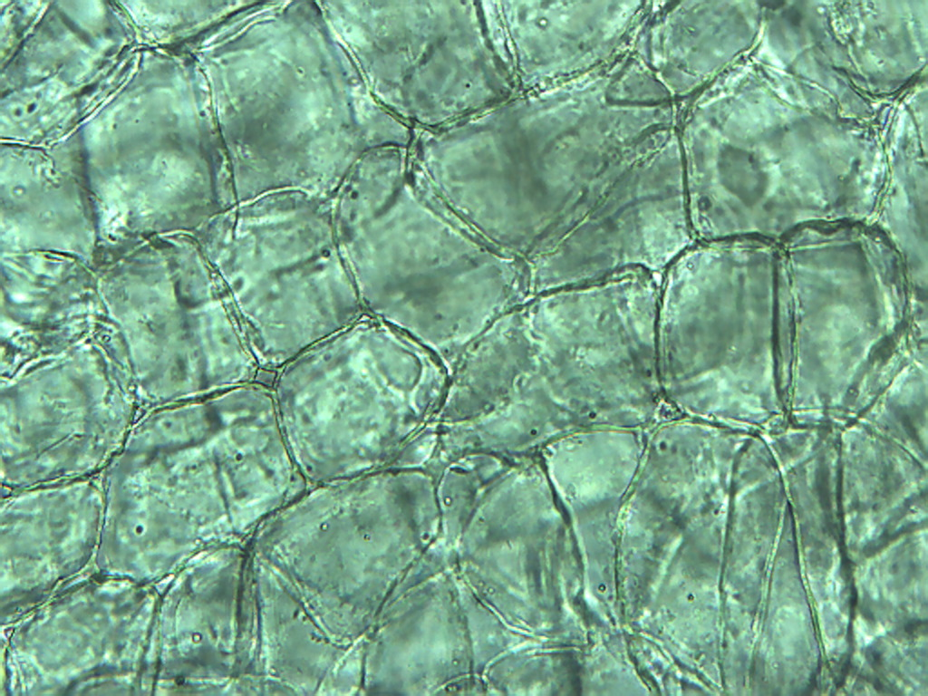
Notes:
425. Radish. Root cells, 25X.

Slide 6
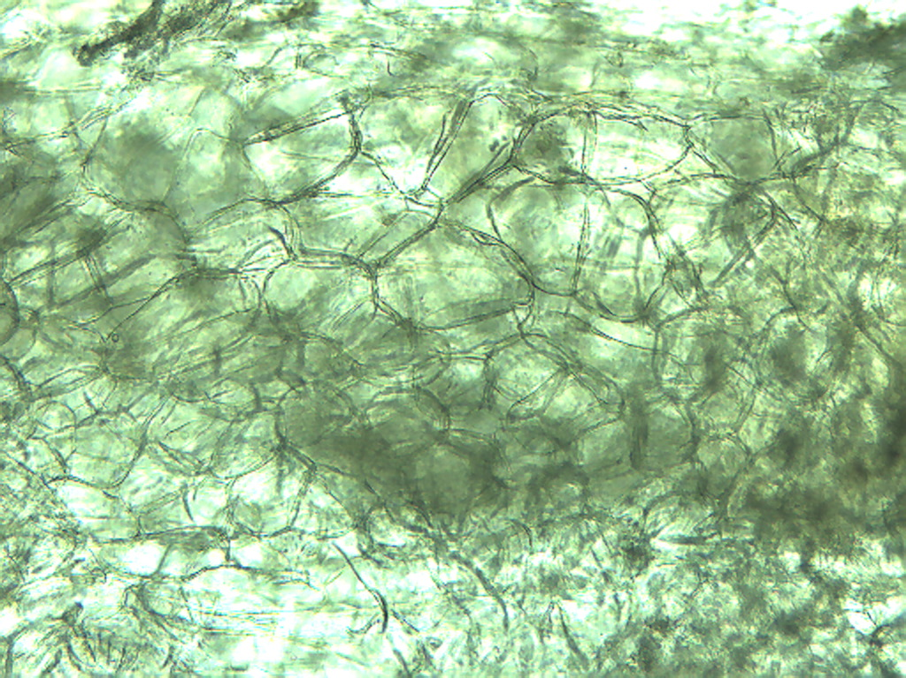
Notes:
426. Radish. Root parenchymal cells, 10X.

Slide 7
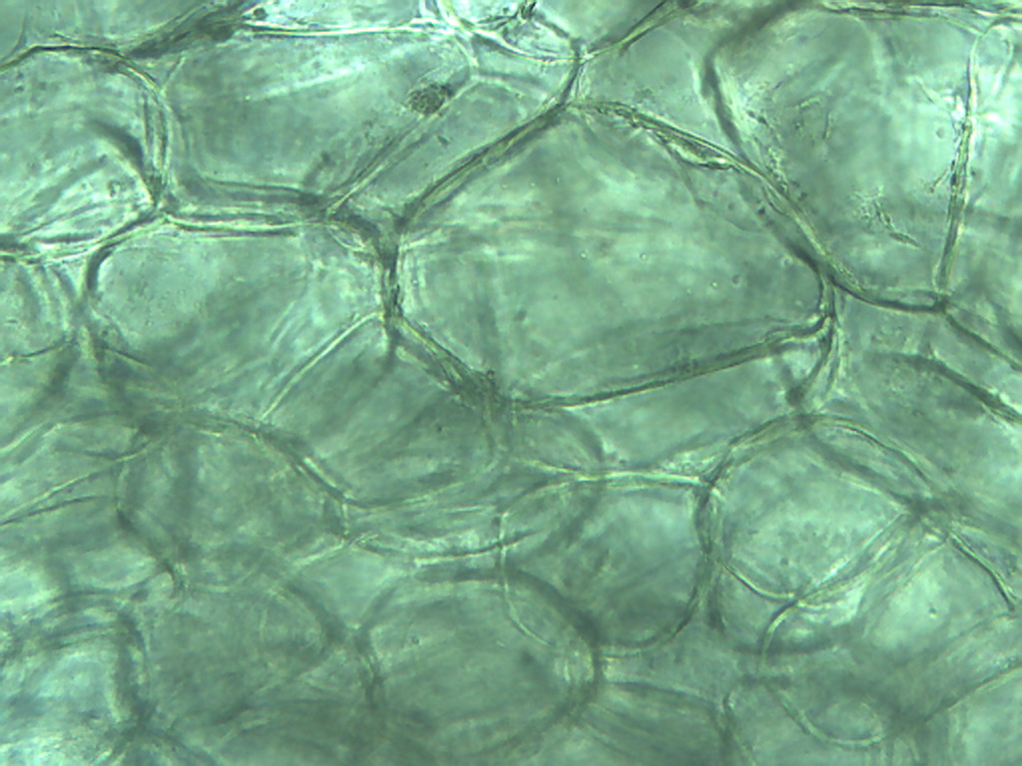
Notes:
427. Radish. Root parenchymal cells, 25X.

Slide 8
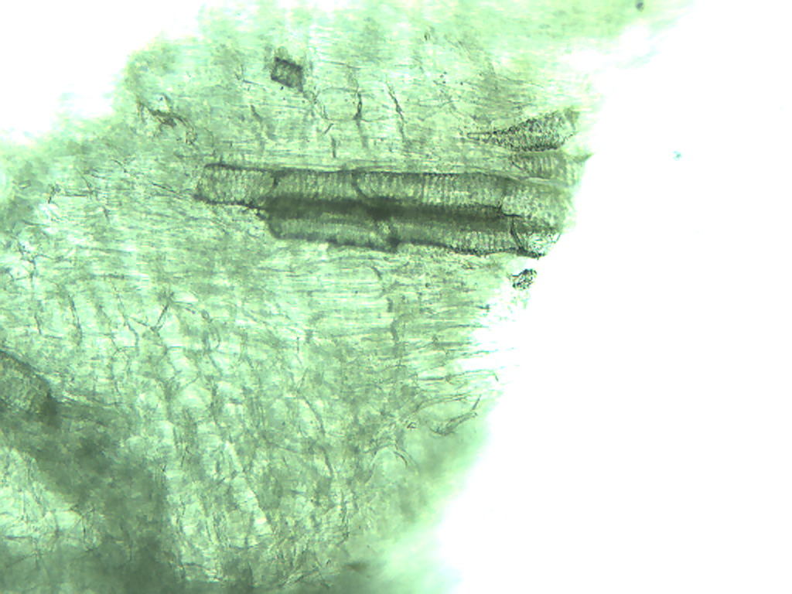
Notes:
428. Radish. Root vascular tissue, 10X.

Slide 9
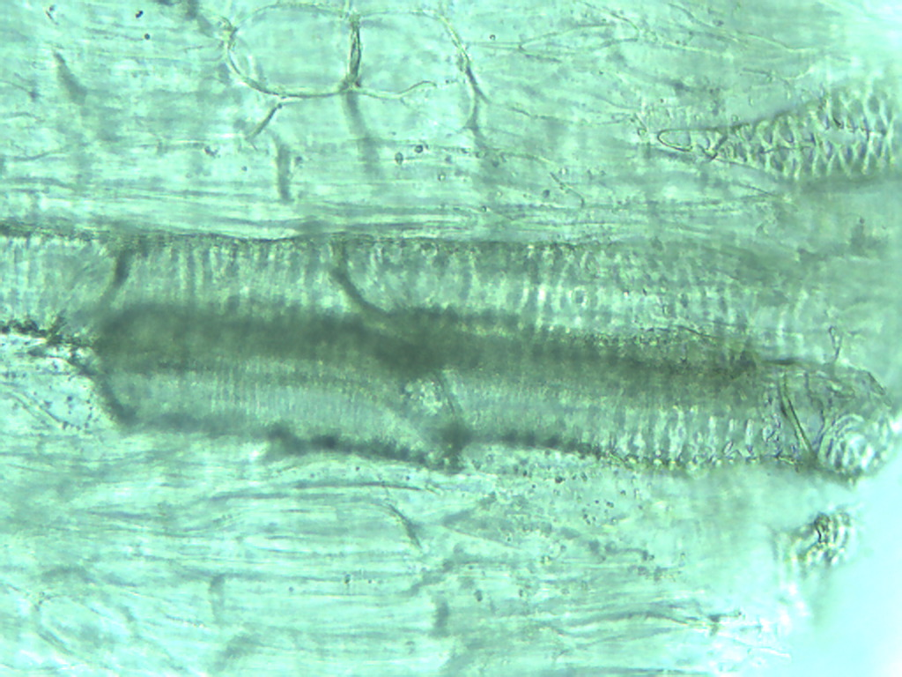
Notes:
429. Radish. Root vascular tissue, 25X.

